Slide 1

Mobile Application Development
Welcome
Class: BS(CS)-VII
Sukkur IBA University – Kandhkot Campus
Week - 04
Lecture – 07
Your Facilitator, Adil Khan

Slide 2
Android Layouts

Slide 3
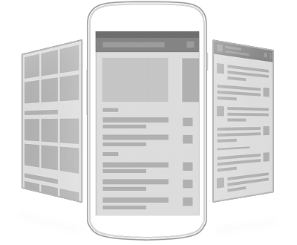
Introduction
The user interface (UI) is everything that the user can see and interact with
Android provides pre-built UI components such as structured layout objects and input controls that you can use to build your UI
Android also provides other modules for special interfaces such as dialogs, notifications and menus

Slide 4
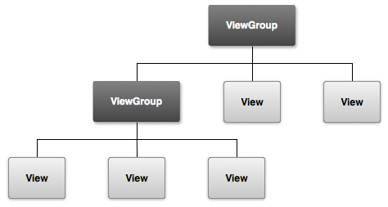
Overview
All Android UI elements built using View and ViewGroup objects
View is an object that draws something on the screen that the user can interact with
ViewGroup is a container that holds Views and other ViewGroup objects and defines layout of all or part of the screen
Views and ViewGroups for a particular screen arranged into a hierarchy

Slide 5
User interface layout
ViewGroup is an invisible container that organizes child Views (some of which might themselves be ViewGroups)
ViewGroup is a subclass of View!
Child Views inside a ViewGroup are widgets or input controls that draw some part of the UI
Make your UI no more complex than it needs to be
It takes more time and memory to construct and display a complex View hierarchy

Slide 6
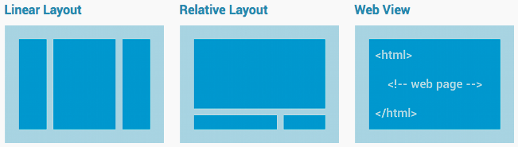
Layouts
Layout defines visual structure of a user interface
e.g., for an Activity or an app widget
You can declare Layouts either in your Java code or in an XML layout file
Can declare default layouts in XML
Modify state of UI components in your code

Slide 7
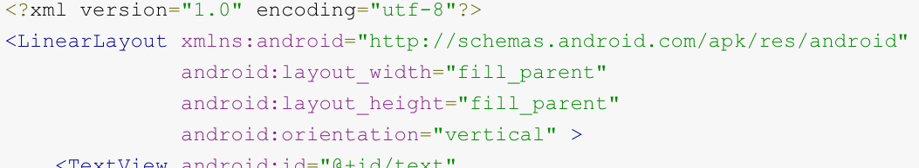
Declaring UI in XML resource
Declaring UI in XML resource lets you separate presentation from logic and behaviour
Can modify presentation without changing code
Can create XML layouts for different screen orientations, sizes and densities or different languages
Easier to debug when layout defined in XML

Slide 8
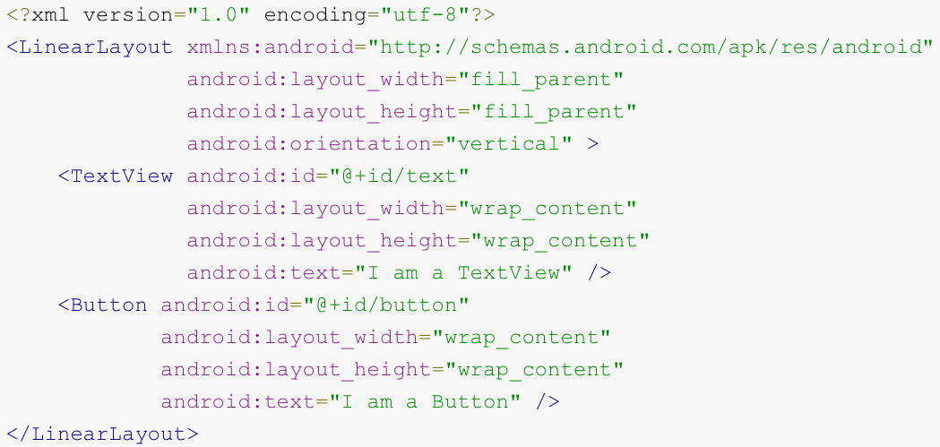
Defining layout in XML
XML vocabulary for defining layouts follows naming of classes and methods
XML element names correspond to class names
XML attribute names correspond to methods
Though there are a couple of small differences
e.g., EditText.setText() corresponds to text attribute

Slide 9
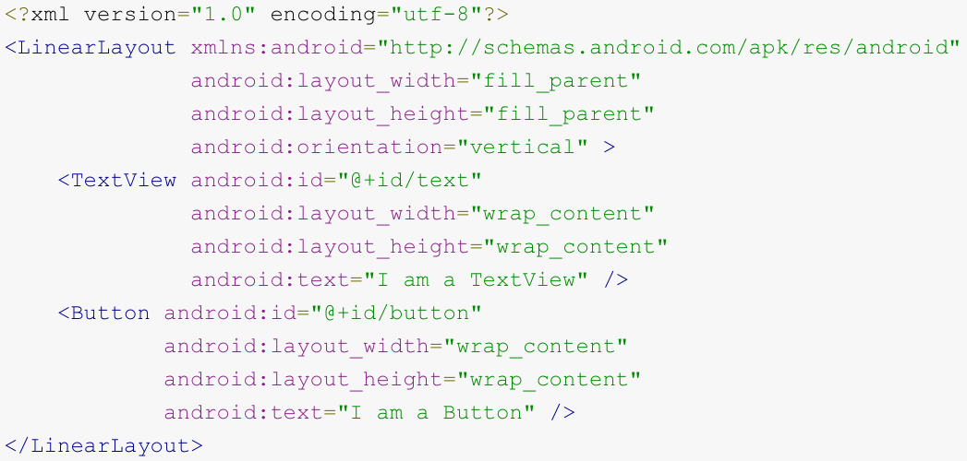
Writing an XML layout file
Each layout file contains one root element, which must be (i.e., correspond to) a View or a ViewGroup object
This will usually be a Layout
Layout is a subclass of ViewGroup!
The root element contains child elements which correspond to Views (often widgets) and ViewGroups (often Layouts)
The layout XML file should end with “.xml” and be stored in the res/layout/ directory

Slide 10
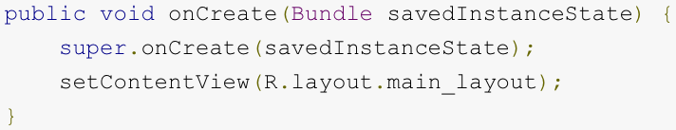
Loading an XML layout resource
When app is compiled, each XML layout file is compiled into a View resource
Load the layout by calling setContentView() from the onCreate() callback implementation in your Activity class
Pass setContentView() the id of the layout resource, as defined in the R.java file
Example shows case for layout declared in main_layout.xml

Slide 11
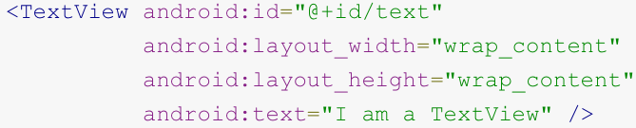
Attributes
Each View and ViewGroup element in an XML layout file has its own set of attributes (e.g., id, text)
These attributes are inherited by any class that subclasses View or ViewGroup
Some attributes are layout parameters that describe layout orientations of a View object (e.g., layout_width, layout_height)

Slide 12
Common Layouts
LinearLayout
RelativeLayout
TableLayout
ScrollView

Slide 13
LinearLayout
LinearLayout is a box model – widgets or child containers are lined up in a column or row, one after the next.
You can use different attributes to control the layout
orientation
fill model
gravity
weight

Slide 14
LinearLayout
LinearLayout: Orientation
indicates whether the LinearLayout represents a row or a column.
Add the android:orientation property to your LinearLayout
Element in your XML layout, setting the value to be horizontal for a row or vertical for a column.
The orientation can be modified at runtime by invoking setOrientation()

Slide 15
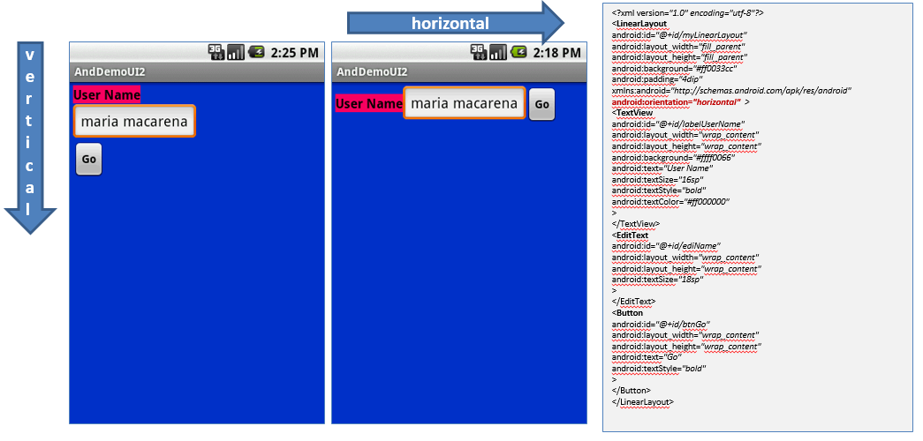
LinearLayout
Orientation indicates whether the LinearLayout represents a row (HORIZONTAL) or a column (VERTICAL).

Slide 16
LinearLayout
LinearLayout: Fill Model
All widgets inside a LinearLayout must supply dimensional attributes
android:layout_width and android:layout_height
to help address the issue of empty space.
Values used in defining height and width are:
Specific a particular dimension, such as 125dip (device independent pixels)
Provide wrap_content, which means the widget should fill up its natural space, unless that is too big, in which case Android can use word-wrap as needed to make it fit.
Provide match_parent, which means the widget should fill up all available space in its enclosing container, after all other widgets are taken care of.

Slide 17
LinearLayout
LinearLayout: weight
LinearLayout also supports assigning a weight to individual children with the android:layout_weight attribute.
This attribute assigns an "importance" value to a view in terms of how much space it should occupy on the screen.
A larger weight value allows it to expand to fill any remaining space in the parent view.

Slide 18
LinearLayout
LinearLayout: weight
To create a linear layout in which each child uses the same amount of space on the screen, set the android:layout_height of each view to "0dp" (for a vertical layout) or the android:layout_width of each view to "0dp" (for a horizontal layout).
Then set the android:layout_weight of each view to "1"

Slide 19
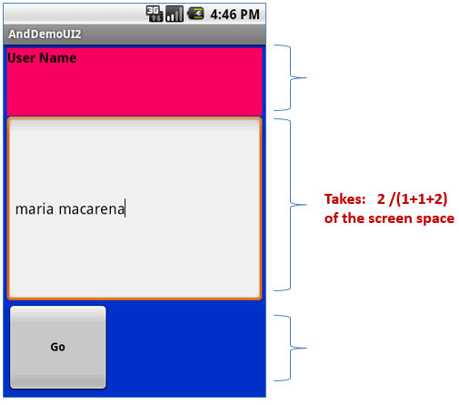
LinearLayout
LinearLayout: weight
If there are three controls and two of them declare a weight of 1, while the third field is then given a weight of 2, then it's now declared more important than both the others, so it gets half the total remaining space, while the first two share the rest equally.

Slide 20
LinearLayout
LinearLayout: gravity
It is used to indicate how a control will align on the screen.
By default, widgets are left- and top-aligned.
You may use the XML property
android:layout_gravity=“…”
to set other possible arrangements:
left, center, right, top, bottom, etc.

Slide 21


LinearLayout
LinearLayout: gravity
gravity vs. layout_gravity
android:gravity: specifies how to place the content of an object, both on the x- and y-axis, within the object itself.
android:layout_gravity: positions the view with respect to its parent (i.e. what the view is contained in).

Slide 22
RelativeLayout
RelativeLayout places widgets based on their relationship to other widgets in the container and the parent container.
Example:
A is by the parent’s top
C is below A, to its right
B is below A, to the left of C
A
B
C

Slide 23
RelativeLayout
Some positioning XML (boolean) properties mapping a widget according to its location respect to the parent’s place are:
android:layout_alignParentTop says the widget's top should align with the top of the container
android:layout_alignParentBottom the widget's bottom should align with the bottom of the container
android:layout_alignParentLeft the widget's left side should align with the left side of the container
android:layout_alignParentRight the widget's right side should align with the right side of the container
android:layout_centerInParent the widget should be positioned both horizontally and vertically at the center of the container
android:layout_centerHorizontal the widget should be positioned horizontally at the center of the container
android:layout_centerVertical the widget should be positioned vertically at the center of the container

Slide 24
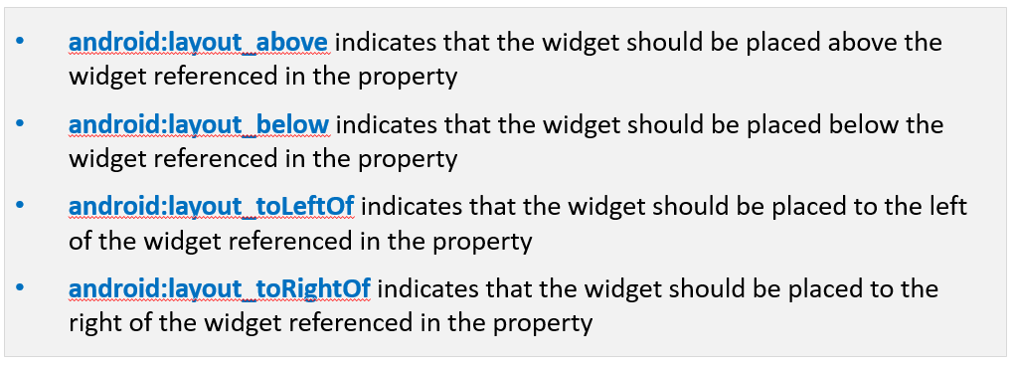
RelativeLayout
The following properties manage positioning of a widget respect to other widgets:

Slide 25
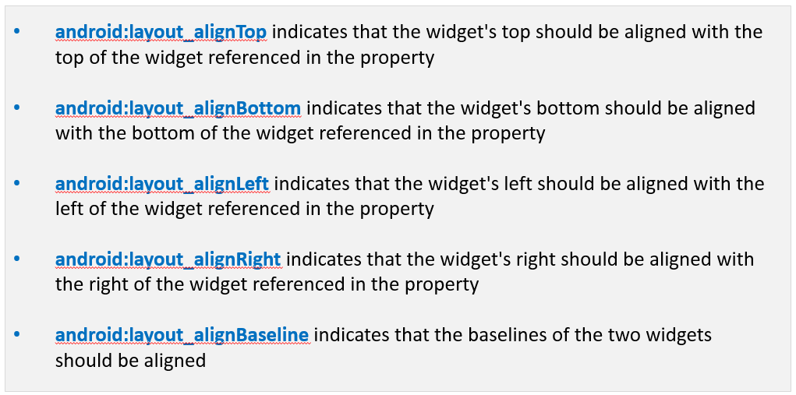
RelativeLayout
Referring to other widgets – cont.

Slide 26
RelativeLayout
In order to use Relative Notation in Properties you need to consistently:
Put identifiers (android:id attributes) on all elements that you will need to address.
Syntax is: @+id/... (for instance an EditText box could be XML called: android:id="@+id/ediUserName")
Reference other widgets using the same identifier value (@+id/...) already given to a widget. For instance a control below the EditText box could say: android:layout_below="@+id/ediUserName"

Slide 27
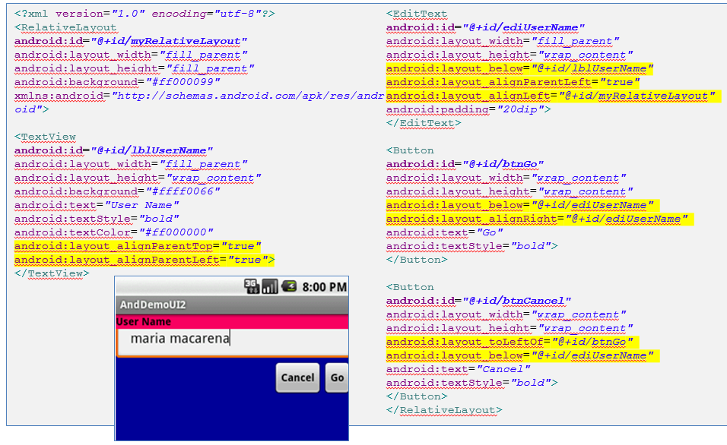
RelativeLayout

Slide 28
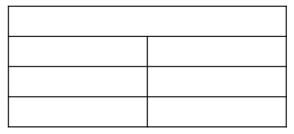
TableLayout
Android's TableLayout allows you to position your widgets in a grid made of identifiable rows and columns.
Columns might shrink or stretch to accommodate their contents.
TableLayout works in conjunction with TableRow.
TableLayout controls the overall behavior of the container, with the widgets themselves positioned into one or more TableRow containers, one per row in the grid.

Slide 29
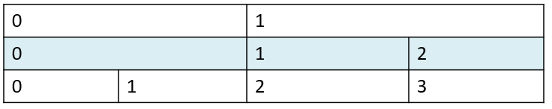
TableLayout
Rows are declared by you by putting widgets as children of a TableRow inside the overall TableLayout.
The number of columns is determined by Android ( you control the number of columns in an indirect way).
So if you have three rows, one with two widgets, one with three widgets, and one with four widgets, there will be at least four columns.

Slide 30
TableLayout
However, a single widget can take up more than one column by including the android:layout_span property, indicating the number of columns the widget spans (this is similar to the colspan attribute one finds in table cells in HTML).
<TableRow>
<TextView android:text="URL:" />
<EditText
android:id="@+id/entry"
android:layout_span="3" />
</TableRow>

Slide 31
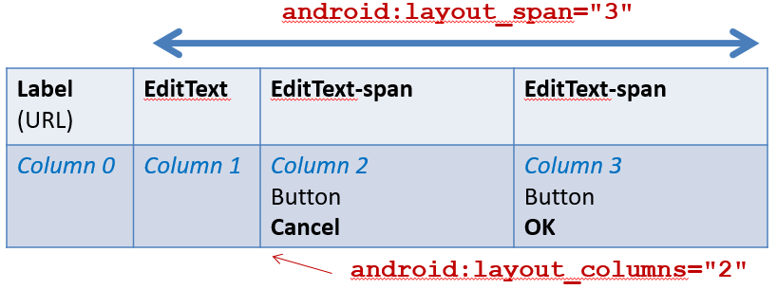
TableLayout
Generally, widgets are put into the first available column of each row.
In the example below, the label (“URL”) would go in the first column (column 0, as columns are counted starting from 0), and the TextField would go into a spanned set of three columns (columns 1 through 3).

Slide 32
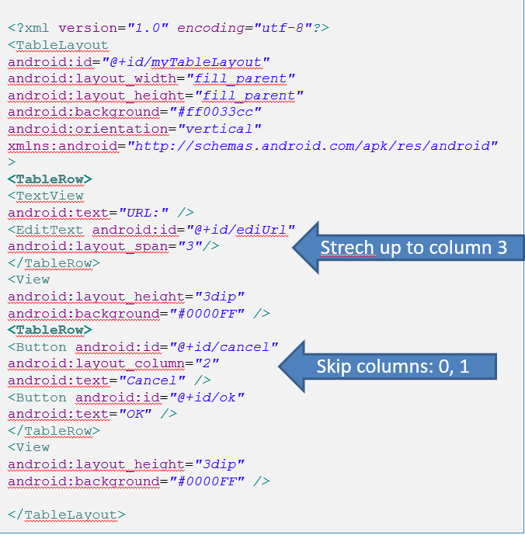
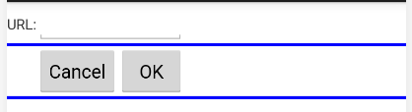
TableLayout

Slide 33
ScrollView
When we have more data than what can be shown on a single screen you may use the ScrollView control.
It provides a sliding or scrolling access to the data. This way the user can only see part of your layout at one time, but the rest is available via scrolling.
This is similar to browsing a large web page that forces the user to scroll up the page to see the bottom part of the form.

Slide 34
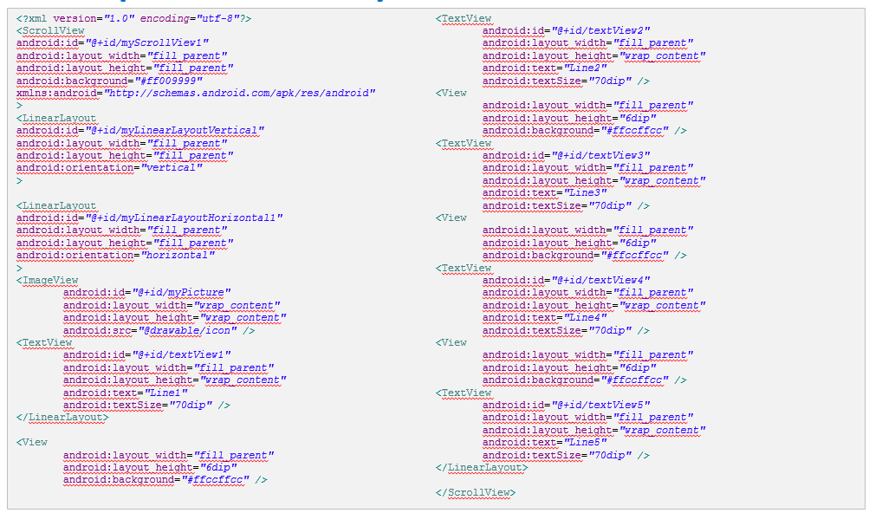
ScrollView

Slide 35
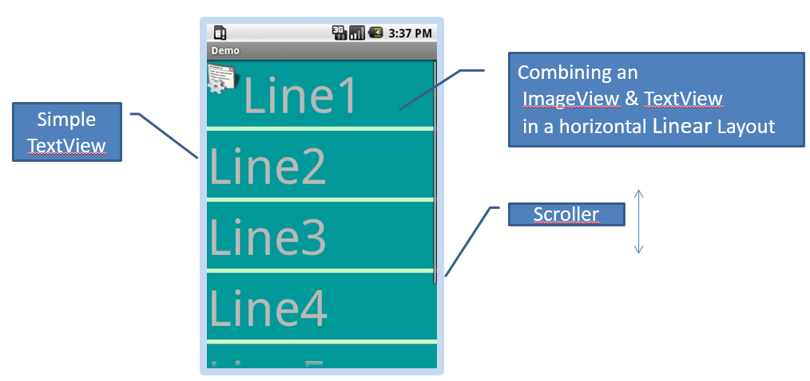
ScrollView

Slide 36
Thank you!
Any Questions???

